Slide 1

SQL PORTFOLIO PROJECT
AAYUSH JOSHI

Slide 2
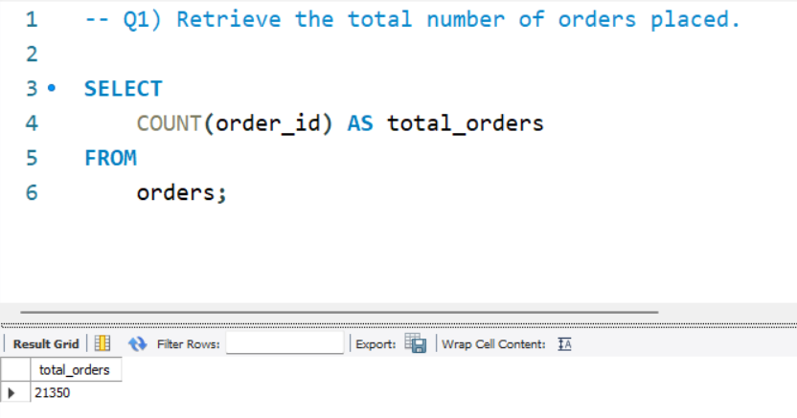
Q1) Retrieve the total number of orders placed.
SELECT COUNT(order_id) AS total_orders FROM orders;

Slide 3
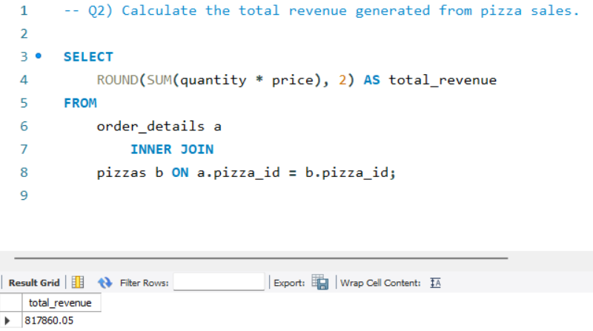
Q2) Calculate the total revenue generated from pizza sales.
SELECT ROUND(SUM(quantity * price), 2) AS total_revenue FROM order_details a INNER JOIN pizzas b ON a.pizza_id = b.pizza_id;

Slide 4
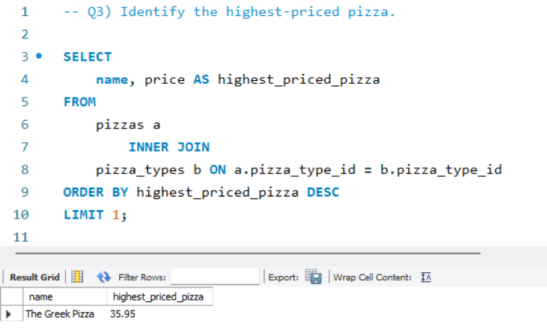
Q3) Identify the highest-priced pizza.
SELECT name, price AS highest_priced_pizza FROM pizzas a INNER JOIN pizza_types b ON a.pizza_type_id = b.pizza_type_id ORDER BY highest_priced_pizza DESC LIMIT 1;

Slide 5
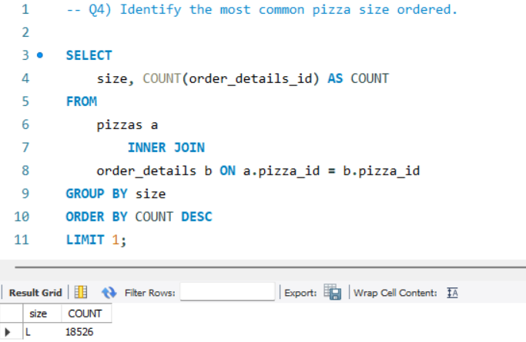
Q4) Identify the most common pizza size ordered.
SELECT size, COUNT(order_details_id) AS COUNT FROM pizzas a INNER JOIN order_details b ON a.pizza_id = b.pizza_id GROUP BY size ORDER BY COUNT DESC LIMIT 1;

Slide 6
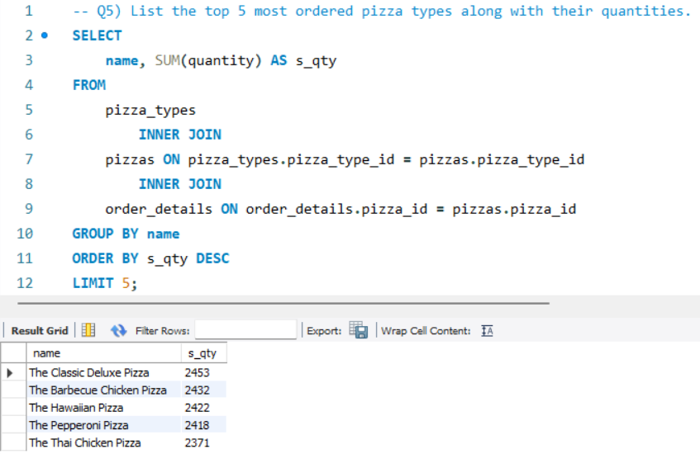
Q5) List the top 5 most ordered pizza types along with their quantities.
SELECT name, SUM(quantity) AS s_qty FROM pizza_types INNER JOIN pizzas ON pizza_types.pizza_type_id = pizzas.pizza_type_id INNER JOIN order_details ON order_details.pizza_id = pizzas.pizza_id GROUP BY name ORDER BY s_qty DESCLIMIT 5;

Slide 7
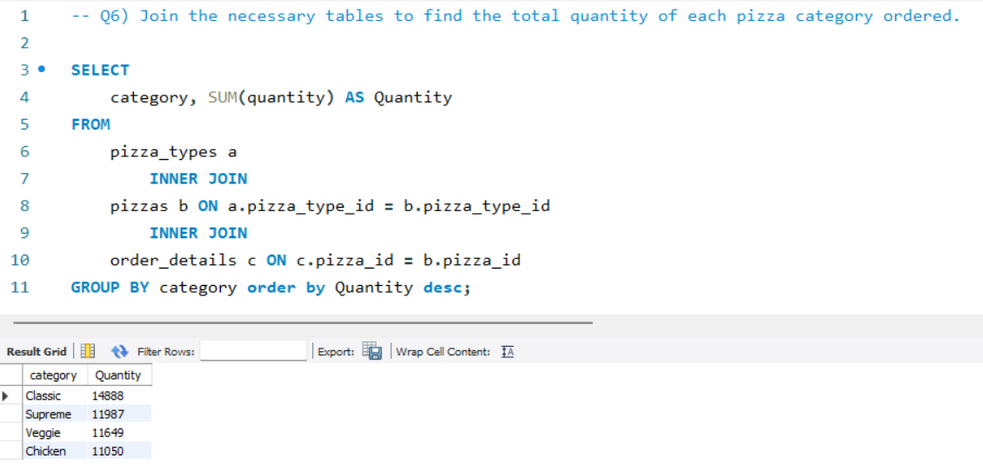
Q6) Join the necessary tables to find the total quantity of each pizza category ordered.
SELECT category, SUM(quantity) AS Quantity FROM pizza_types a INNER JOIN pizzas b ON a.pizza_type_id = b.pizza_type_id INNER JOIN order_details c ON c.pizza_id = b.pizza_id GROUP BY category order by Quantity desc;

Slide 8
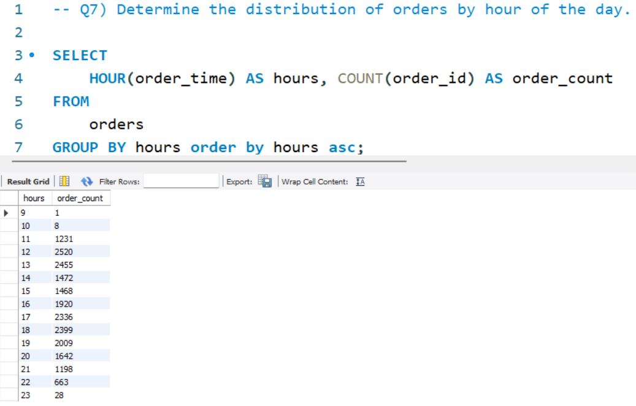
Q7) Determine the distribution of orders by hour of the day.
SELECT HOUR(order_time) AS hours, COUNT(order_id) AS order_count FROM orders GROUP BY hours order by hours asc;

Slide 9
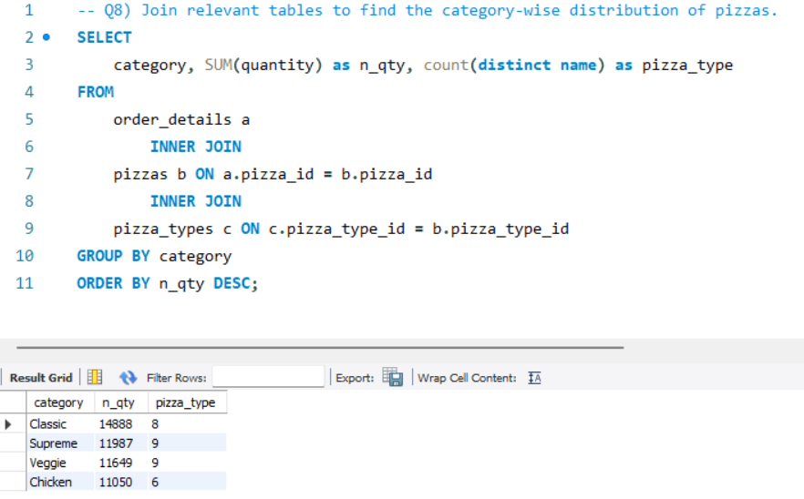
Q8) Join relevant tables to find the category-wise distribution of pizzas.
SELECT category, SUM(quantity) as n_qty, count(distinct name) as pizza_type FROM order_details a INNER JOIN pizzas b ON a.pizza_id = b.pizza_id INNER JOIN pizza_types c ON c.pizza_type_id = b.pizza_type_id GROUP BY category ORDER BY n_qty DESC;

Slide 10
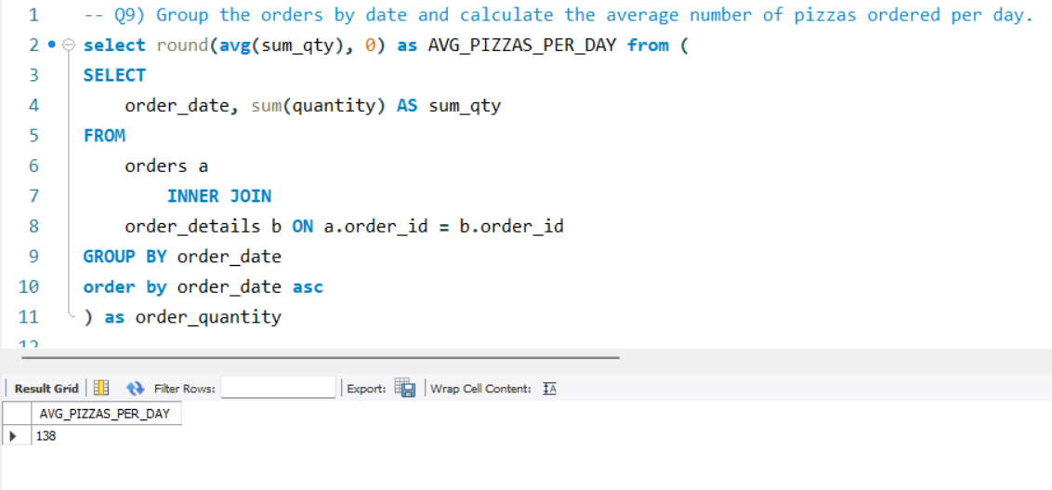
Q9) Group the orders by date and calculate the average number of pizzas ordered per day.
select round(avg(sum_qty), 0) as AVG_PIZZAS_PER_DAY from (SELECT order_date, sum(quantity) AS sum_qty FROM orders a INNER JOIN order_details b ON a.order_id = b.order_id GROUP BY order_date order by order_date asc) as order_quantity

Slide 11
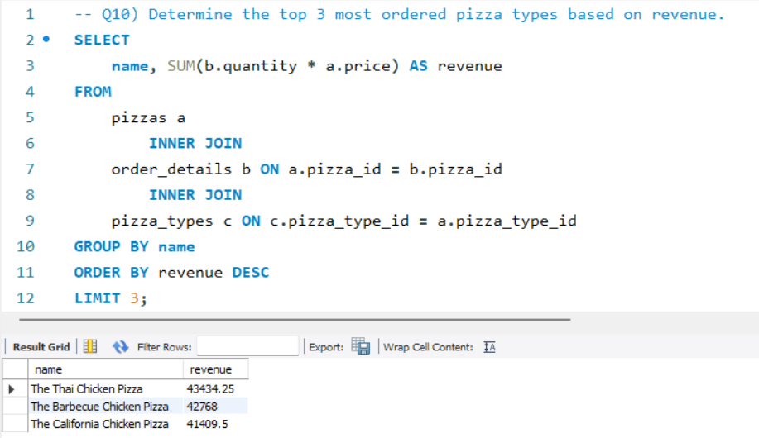
Q10) Determine the top 3 most ordered pizza types based on revenue.
SELECT name, SUM(b.quantity * a.price) AS revenue FROM pizzas a INNER JOIN order_details b ON a.pizza_id = b.pizza_id INNER JOIN pizza_types c ON c.pizza_type_id = a.pizza_type_id GROUP BY name ORDER BY revenue DESCLIMIT 3;

Slide 12
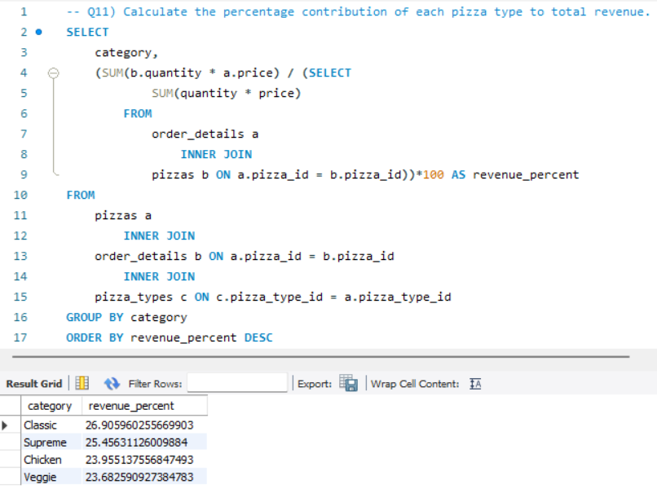
Q11) Calculate the percentage contribution of each pizza type to total revenue.
SELECT category, (SUM(b.quantity * a.price) / (SELECT SUM(quantity * price) FROM order_details a INNER JOIN pizzas b ON a.pizza_id = b.pizza_id))*100 AS revenue_percent FROM pizzas a INNER JOIN order_details b ON a.pizza_id = b.pizza_id INNER JOIN pizza_types c ON c.pizza_type_id = a.pizza_type_id GROUP BY category ORDER BY revenue_percent DESC

Slide 13
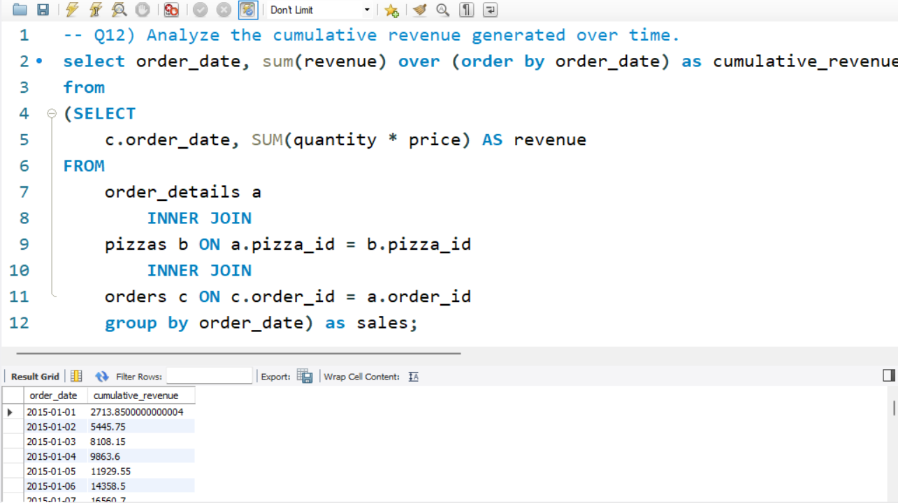
Q12) Analyze the cumulative revenue generated over time.
select order_date, sum(revenue) over (order by order_date) as cumulative_revenue from (SELECT c.order_date, SUM(quantity * price) AS revenue FROM order_details a INNER JOIN pizzas b ON a.pizza_id = b.pizza_id INNER JOIN orders c ON c.order_id = a.order_id group by order_date) as sales;

Slide 14
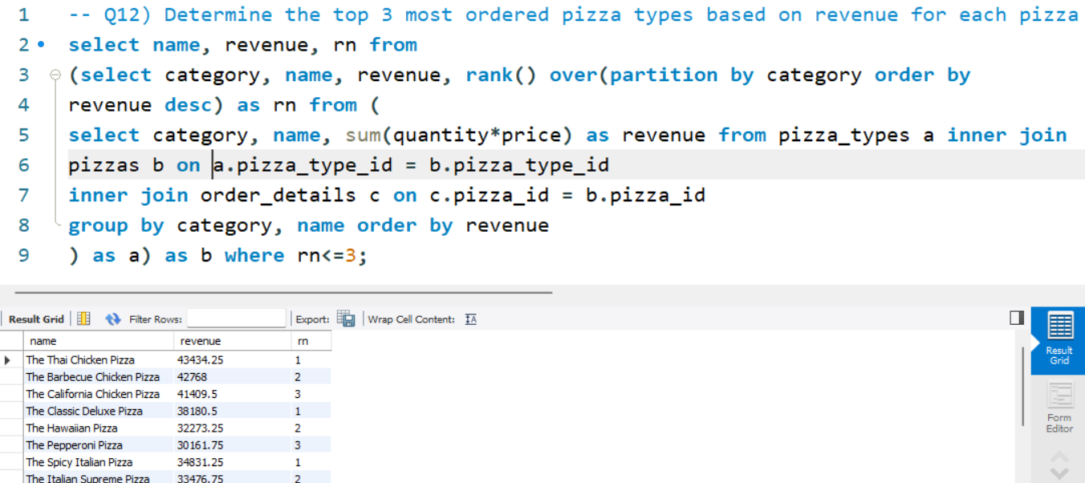
Q13) Determine the top 3 most ordered pizza types based on revenue for each pizza category.
select name, revenue, rn from (select category, name, revenue, rank() over(partition by category order by revenue desc) as rn from (select category, name, sum(quantity*price) as revenue from pizza_types a inner join pizzas b on a.pizza_type_id = b.pizza_type_id inner join order_details c on c.pizza_id = b.pizza_id group by category, name order by revenue) as a) as b where rn<=3;

Slide 15
THANK YOU

